Slide 1
DA Final Presentation
Zach Barber

Slide 2
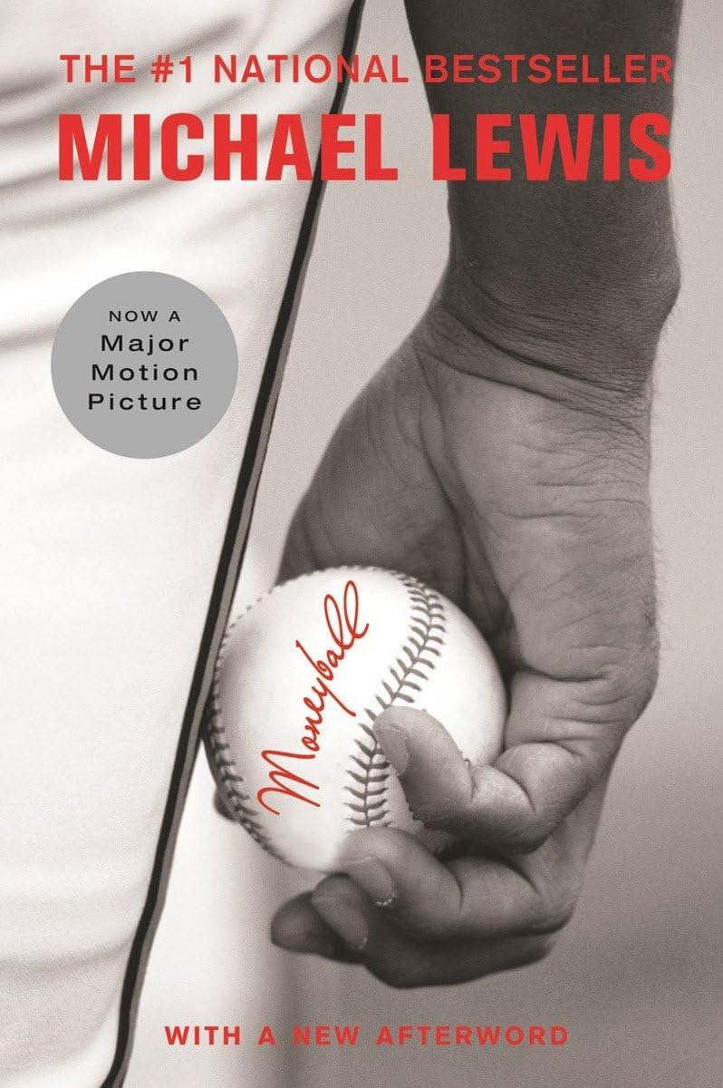
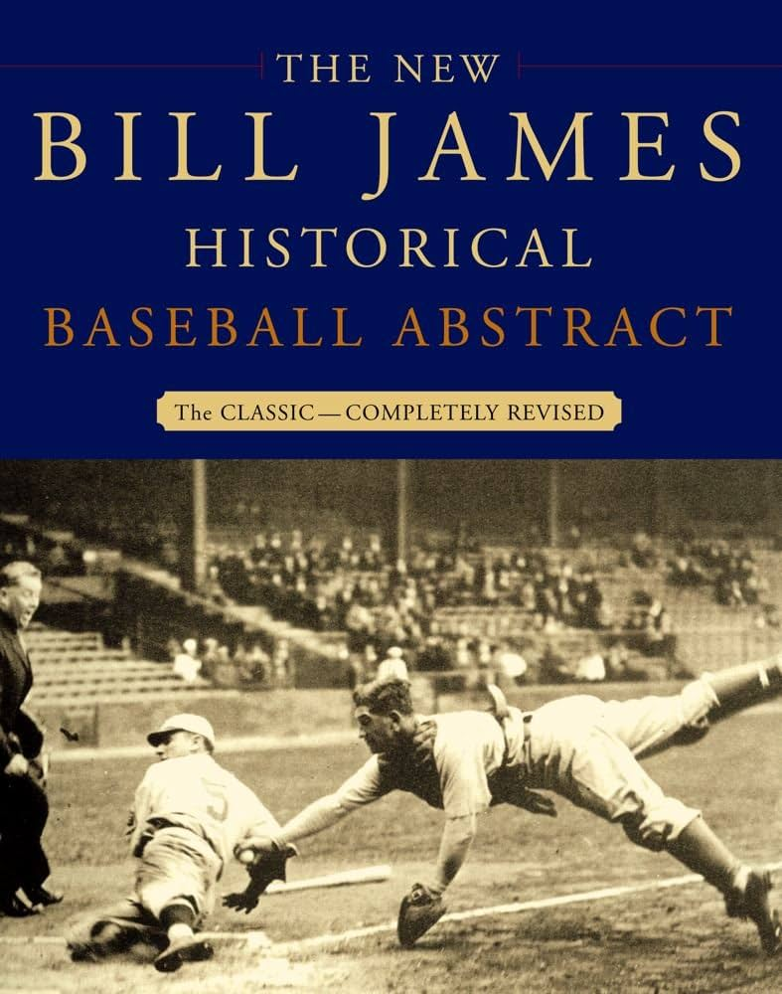

Background
Bill James
Sabermetrics
Moneyball

Slide 3
Research Question(s)
Can I predict the number of wins a given Major League Baseball team will have in a season based on specific team statistics?
Which statistics are most correlated with the number of wins a team has?
Are “Moneyball” statistics better at predicting wins than more traditional ones?
This analysis could be used by teams for a variety of reasons:
Choosing which players to draft/trade for
Deciding which statistics to focus on to give the best chance of success. “If we have a team OPS of x amount or if we hit x amount of doubles, we are predicted to have x amount of wins.”
Choosing a game plan. Power hitting? Small ball?
Notes:
Mention how correlation doesn’t necessarily imply causation with 2nd reason for analysis usage. Just because a team hits a threshold for a specific stat does not automatically guarantee that they are successful or will have that exact amount of wins.
I don’t really address this third research question in my presentation but I did find that on the macro, team level, there isn’t much of a difference between the moneyball predictors and more traditional metrics

Slide 4
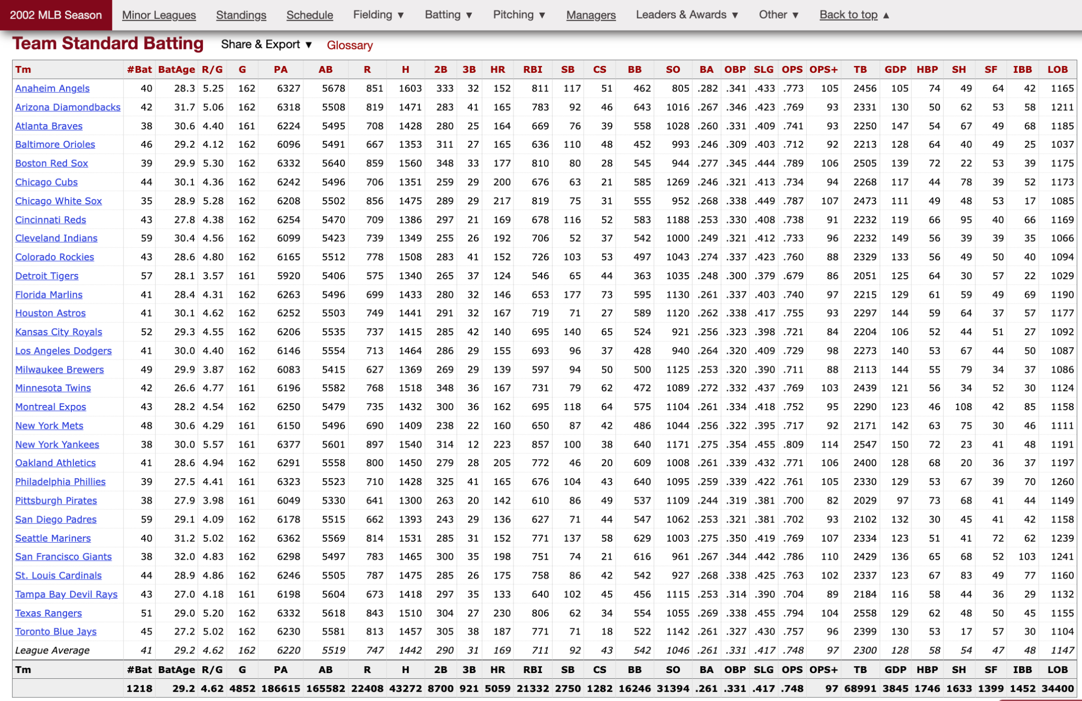

Data Set

Slide 5
Standardization
Data Manipulation

Slide 6
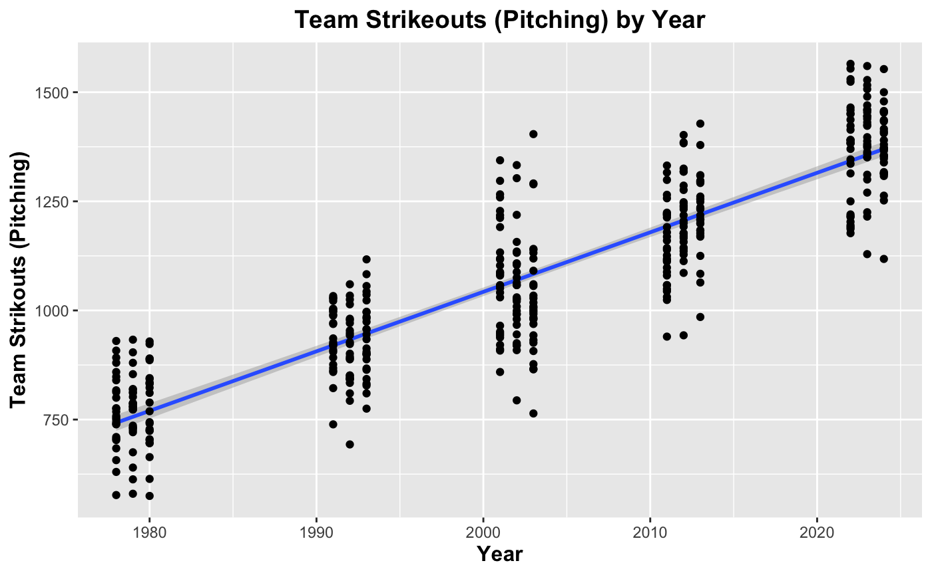
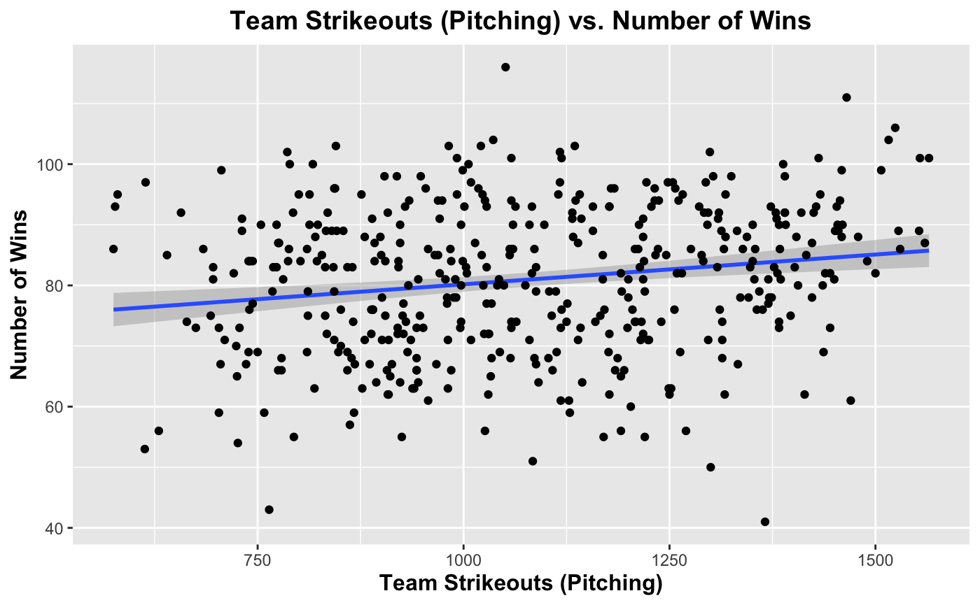
Before Standardization
Strikeouts (Pitching)

Slide 7
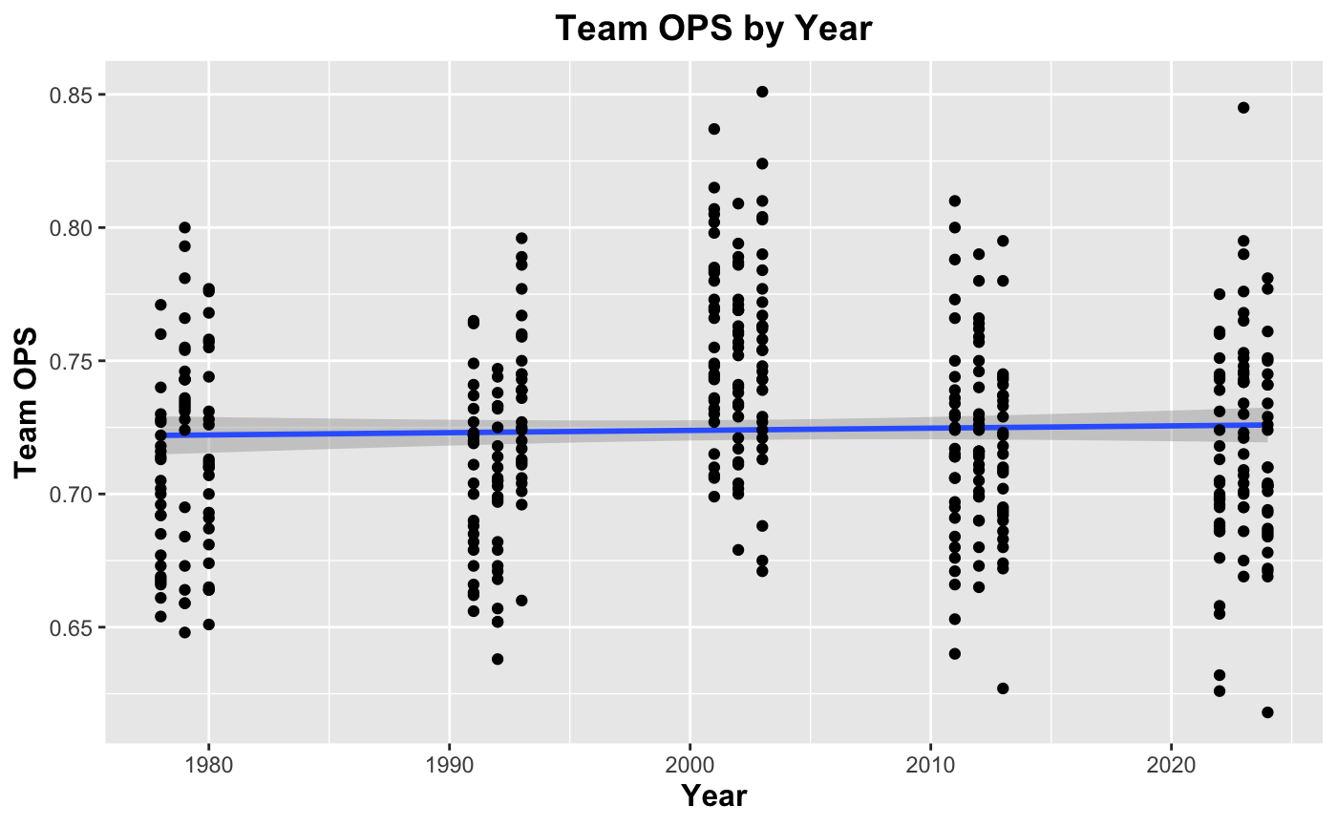
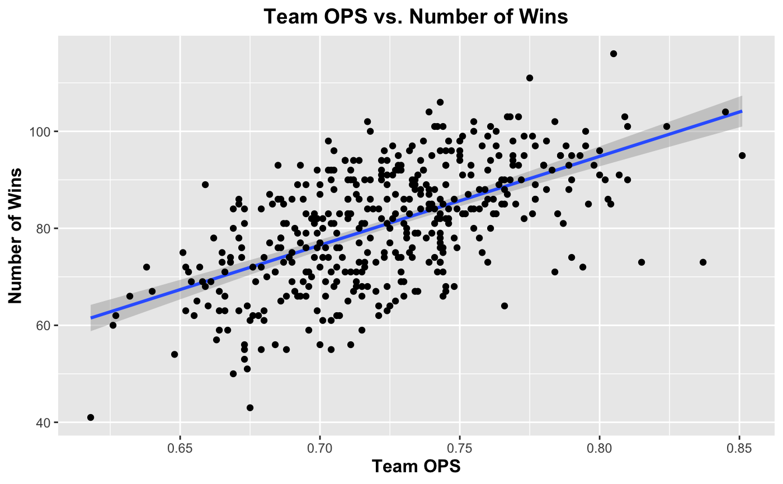
Before Standardization
OPS (On Base plus Slugging Percentage)

Slide 8
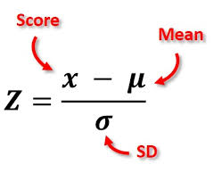

Slide 9
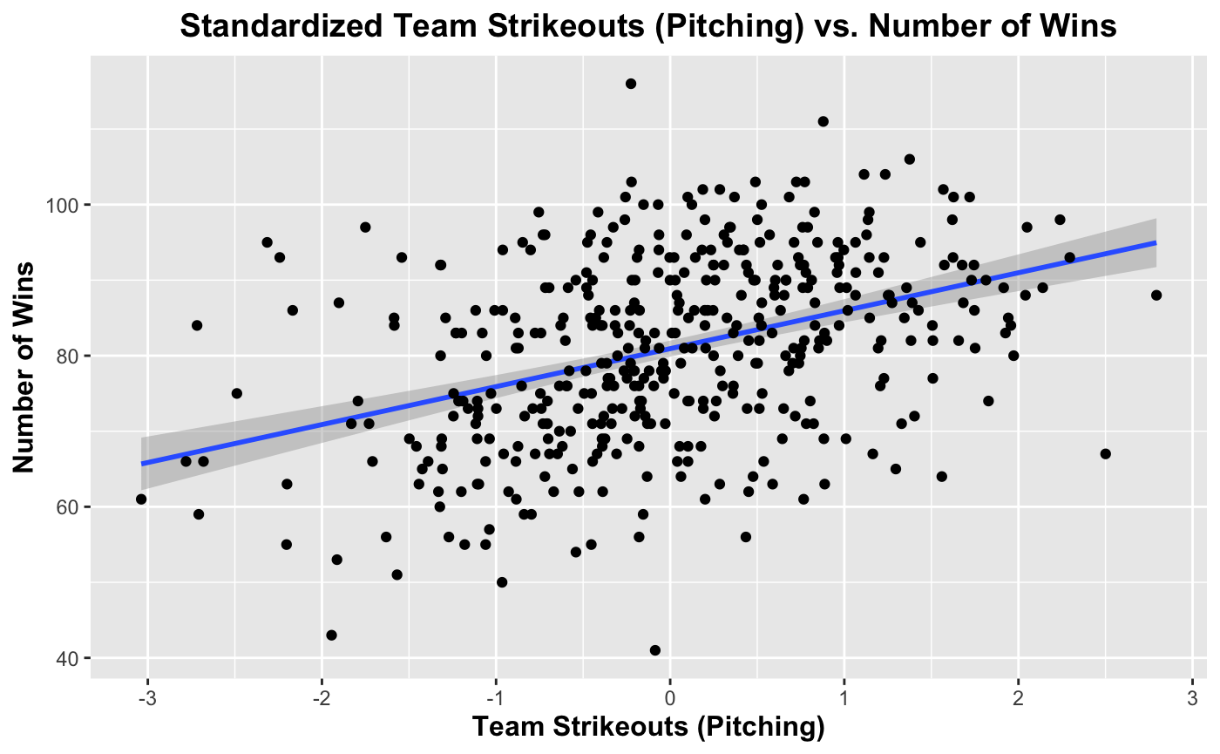
After Standardization
Strikeouts (Pitching)

Slide 10
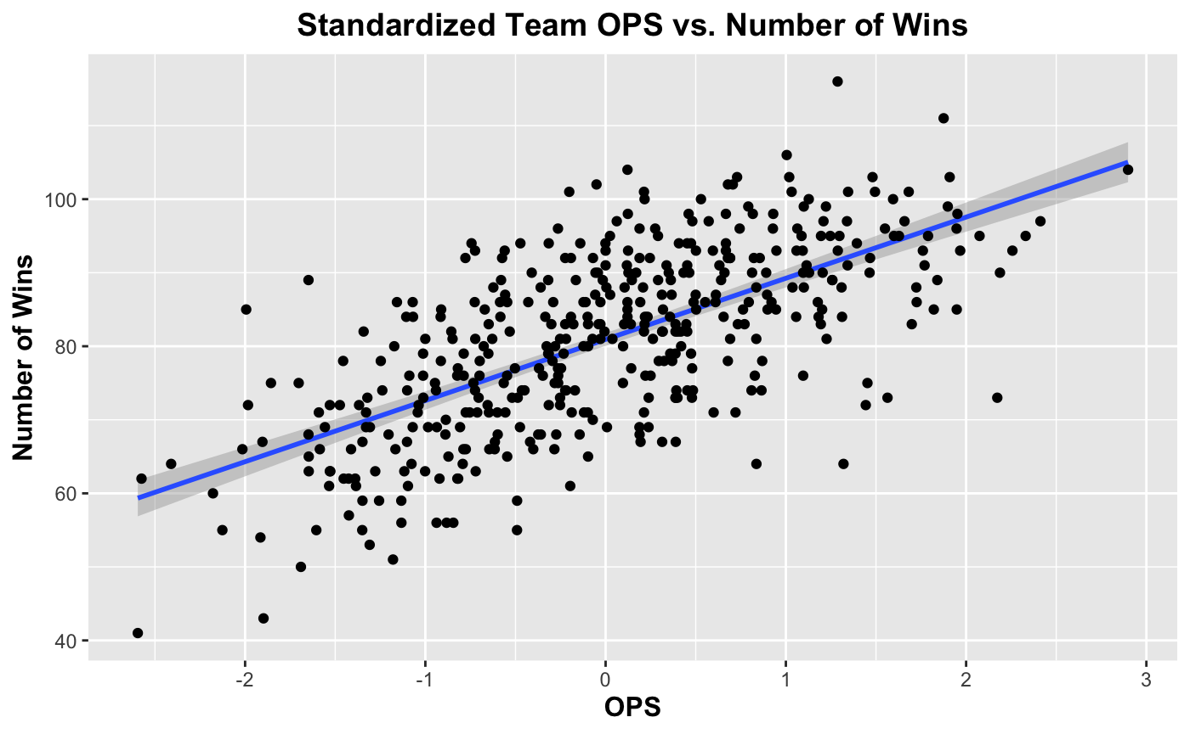
After Standardization
OPS (On Base plus Slugging Percentage)

Slide 11
Regression
Predictive/Inferential Analysis

Slide 12
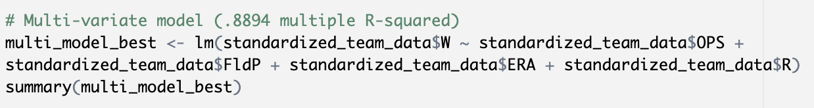
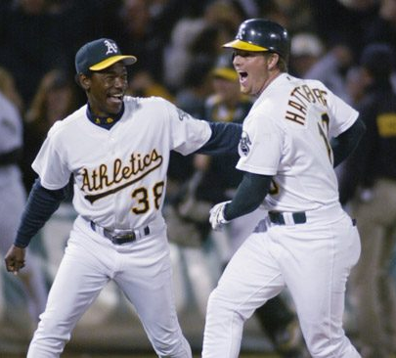
Linear Regression Model
OPS: On Base Plus Slugging Percentage
FldP: Fielding Percentage
ERA: Earned Run Average
R: Runs Scored

Slide 13
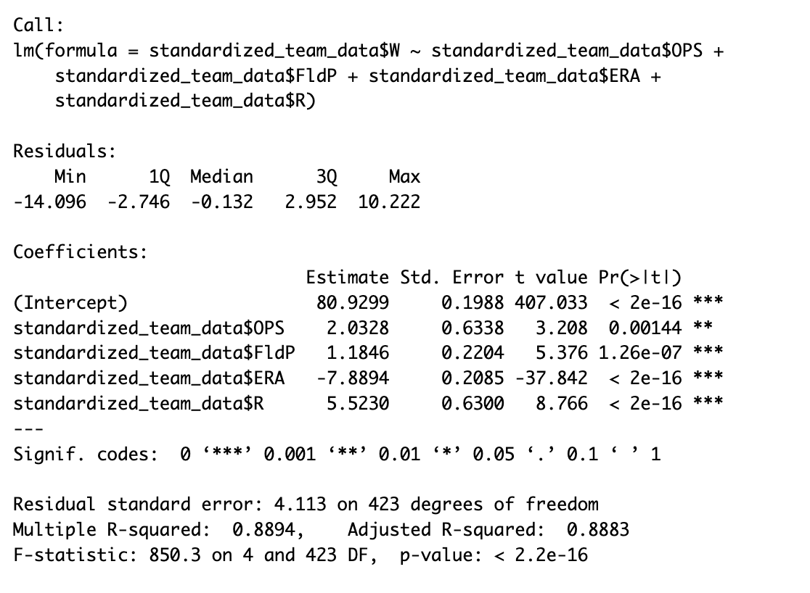
Results
Notes:
P-values indicate that the results are statistically significant
Multiple r-squared and adjusted r-squared values tell us that about 89% of the variation in y can be attributed to these x-variables. In the specific case of this model, about 89% of the variation in win totals can be attributed to team OPS, team Fielding Percentage, team ERA, and team run total. This signifies a strong correlation.

Slide 14
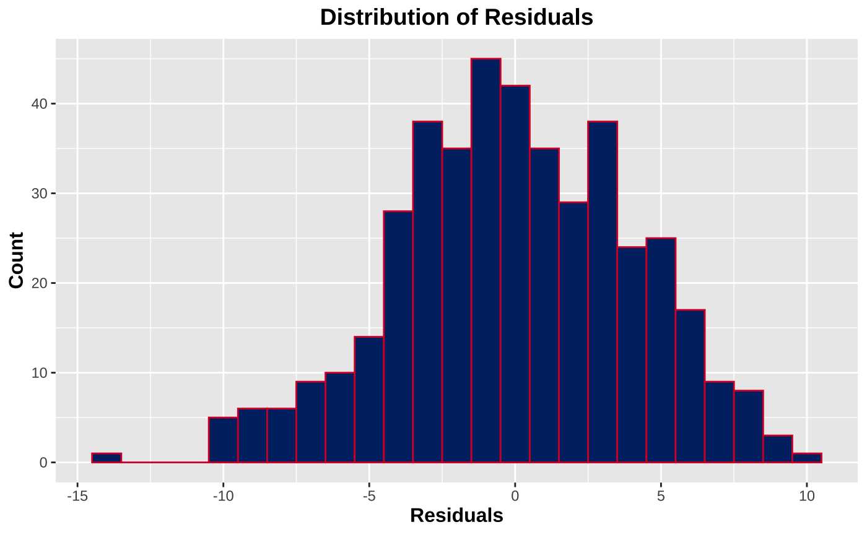
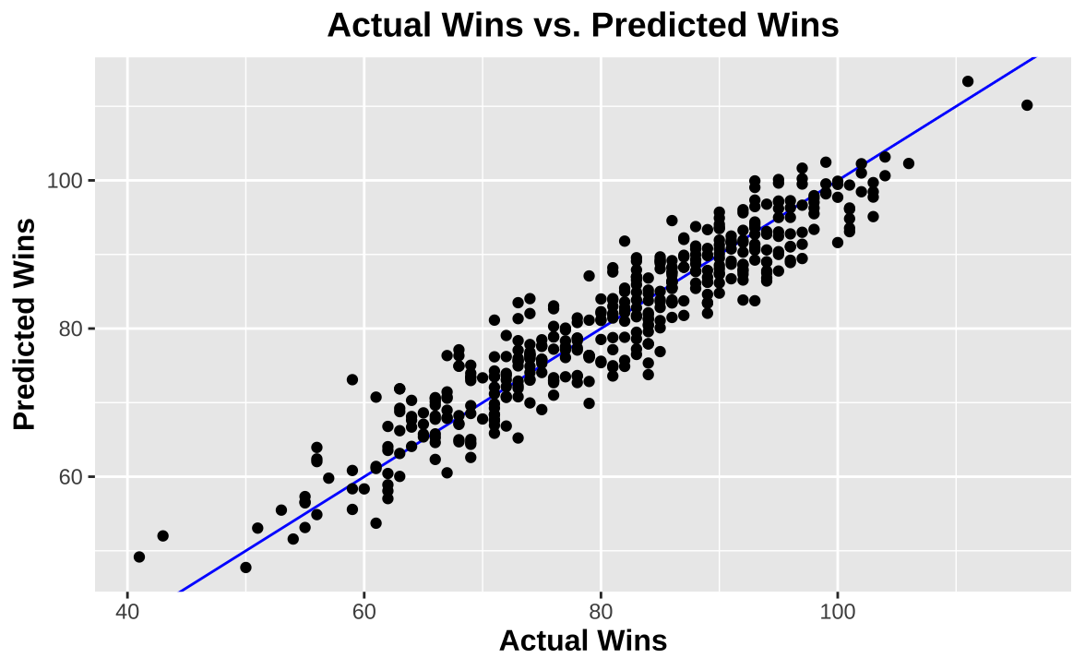
Analysis

Slide 15
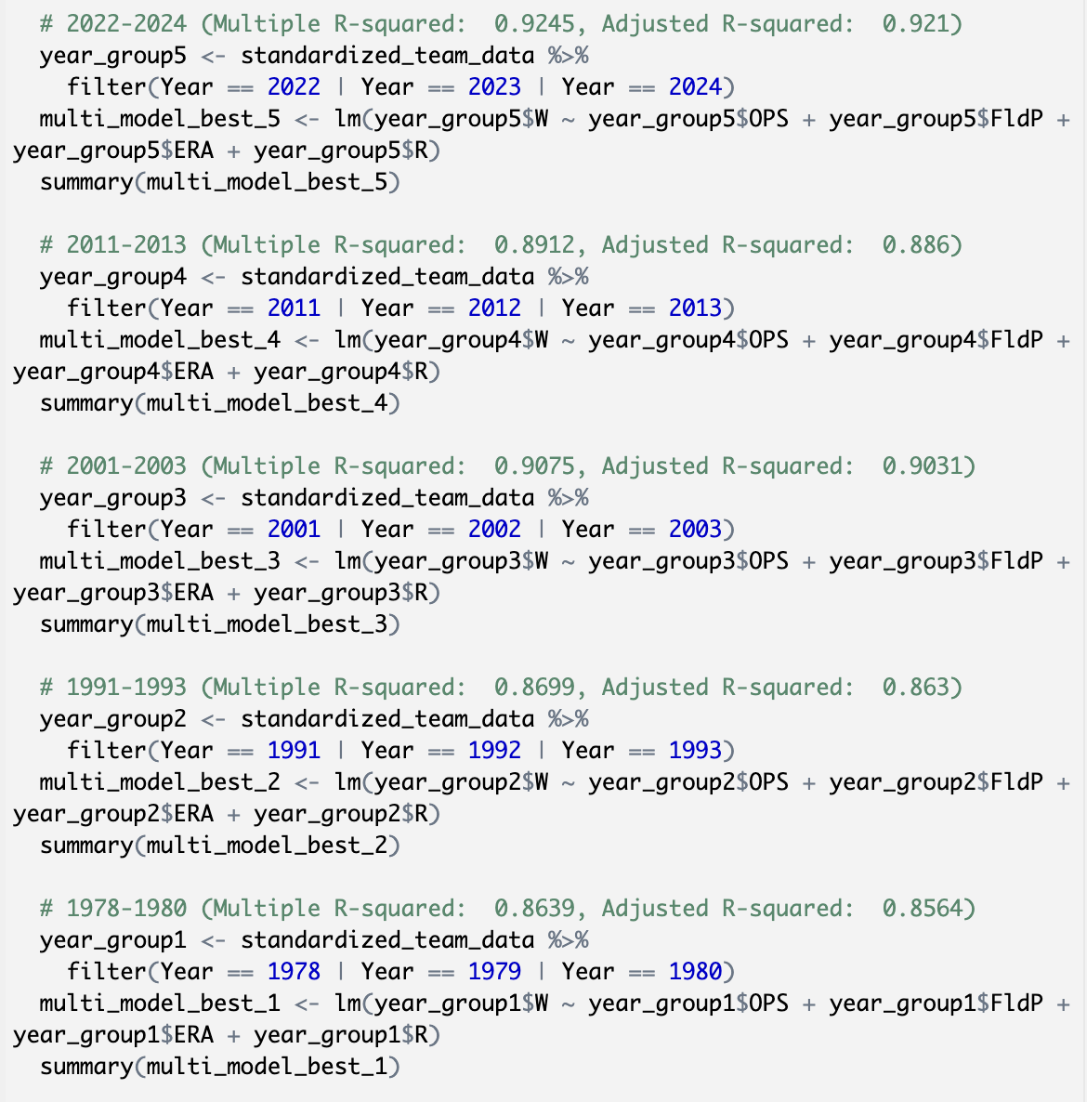
Additional Testing
Notes:
The model is a bit better at predicting win totals for the more recent seasons that I tested. This may be another indication that the game has changed throughout the years and that the metrics that are most influential in determining a team’s win total today are not the same as they were 30 to 40 years ago.

Slide 16
Key Takeaways

Slide 17
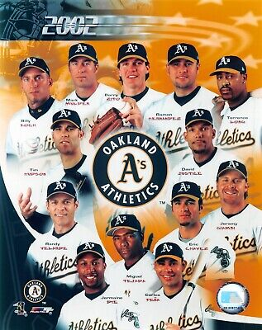
What’s Next?
“More than 20 years later, other franchises combined the "Moneyball" idea with big money payroll. It is something the Los Angeles Dodgers, San Francisco Giants and New York Yankees have used in recent years to find an edge.”
Use salary data
Focus on individual players instead of teams as a whole
Notes:
When I started working on this project, I thought that I might come to some revolutionary conclusions, but after spending so much time with the data, I realize that this is all very surface level and is kind of intuitive. Obviously the more runs a team scores or the better their pitching or fielding is, the more wins they should have. I will say that it was interesting to see just how influential each stat is on win total according to the models I created.
If I had more time to complete this project or were to complete a similar project in the future here are some things I would do:
Use salary data. I originally planned to use it but was unable to find data that I could easily use for all years I was testing.
Focus on individual players and their impact on win totals. This would dive a bit deeper into the data and might allow me to make more interesting conclusions. Also would be a better implementation of the “moneyball” analyses because moneyball focuses more on individual statistics as opposed to full teams.
Study whether the moneyball idea works just as well for teams with more money. Maybe at a certain point in money available to spend, it is better to just go for high caliber power hitters as opposed to playing “small ball” using the limited resources smaller market teams have.
Use salary data to argue for the implementation of a salary cap.

Slide 18
Lewis admitted in an interview with the San Francisco Chronicle that he thinks the "Moneyball" approach to the game was ultimately bad for baseball.
"I think that’s true. It turns out that the smart way to play baseball is boring," Lewis told the paper. …
The problem is that it’s already a slow sport in an age that doesn’t like slow sports and if you’re going to do it smart, you make it slower.

Slide 19
References
Baseball-Reference.com. (2024). Major League Baseball Team Statistics. Retrieved December 8, 2024. https://www.baseball-reference.com
Gaydos, R. (2024, September 25). “Moneyball” author makes stunning admission about analytics use in baseball. Fox News. https://www.foxnews.com/sports/moneyball-author-makes-stunning-admission-about-analytics-use-baseball
James, B. (2001). The New Bill James Historical Baseball Abstract. Free Press.
Lewis, M. (2003). Moneyball: The art of winning an unfair game. W.W. Norton.
Wassermann, E., Czech, D. R., Wilson, M. J., & Joyner, A. B. (2015, March 20). An Examination of the Moneyball Theory: A Baseball Statistical Analysis. The Sport Journal. https://thesportjournal.org/article/an-examination-of-the-moneyball-theory-a-baseball-statistical-analysis/

Slide 20
Thanks!

